Slide 1

Lecture # 02
How Formal Methods are applied

Slide 2
DIJKSTRA’s PUZZLE
Number of balls is put into the jar, and as long as the jar contains two or more balls, the player repeats the following move:
he shakes the jar and, without looking, he takes two balls from the jar;
if those two balls have the same color he throws one black ball back into the jar,
otherwise he return one white ball into the jar.

Slide 3
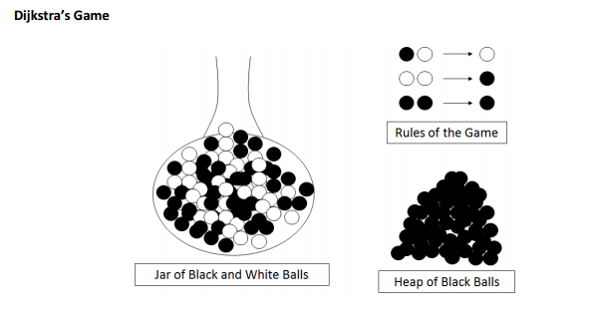
DIJKSTRA’s PUZZLE

Slide 4
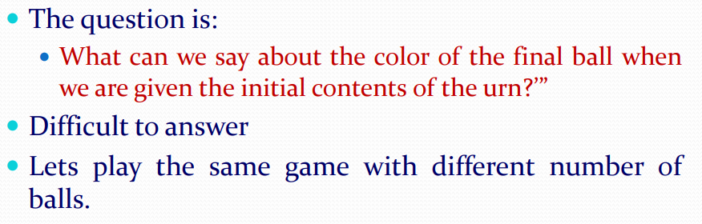
DIJKSTRA’s PUZZLE

Slide 5
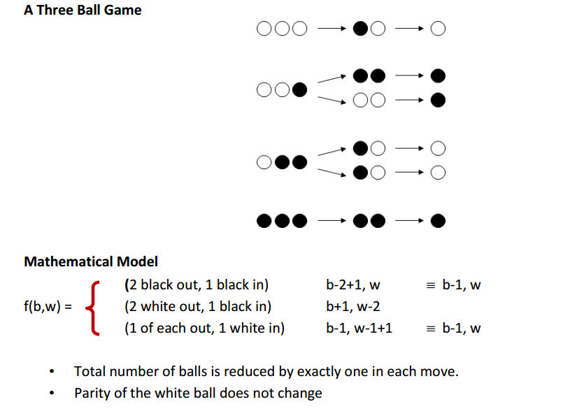
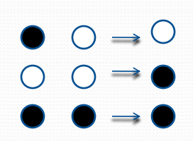
DIJKSTRA’s PUZZLE
One ball game
The game will end without playing
Two balls game
Three different combinations of balls
One Black, one white
One White ,one white
One Black, one black
Three balls game
Six different combinations of balls

Slide 6
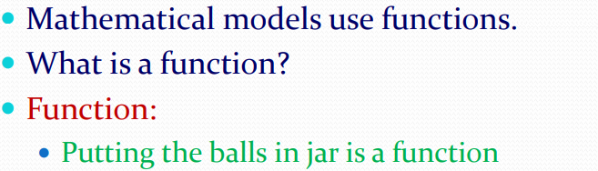
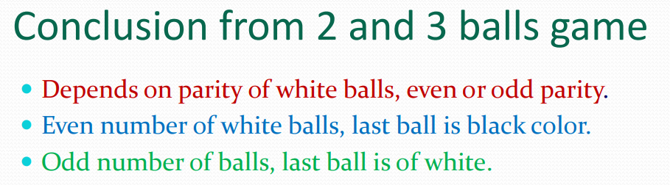
DIJKSTRA’s PUZZLE

Slide 7
DIJKSTRA’s PUZZLE
What is the color of last ball, given w white balls and b black balls?
Yes we will say the parity of white balls determine the outcome of the game.

Slide 8
REFERENCE
Sorin Istrail – “Computer Science Through jar Games: An Unified Framework for a Hierarchy of Solvable and Unsolvable Problems” - Brown University

